Slide 1

Invitation Game
Turn up the volume to hear instructions.
Please adjust the zoom in your browser until you can see the blue border of this slide.
RUN 1
RIGHT
PRESS THE RIGHT BUTTON TO CONTINUE
Notes:
Outside the scanner

Slide 2
This game has 3 modules.
We will introduce you to one module at a time to avoid confusion.
LEFT
RIGHT
PRESS THE RIGHT KEY TO CONTINUE

Slide 3
Module 1
LEFT
RIGHT
PRESS THE RIGHT KEY TO CONTINUE

Slide 4
In this game, we want you to imagine you are planning a big party. In order to get as many people to come to this party as possible, you will go into two different buildings to interact with people and offer invitations:
a library and an office building.
LEFT
RIGHT
PRESS THE RIGHT KEY TO CONTINUE

Slide 5

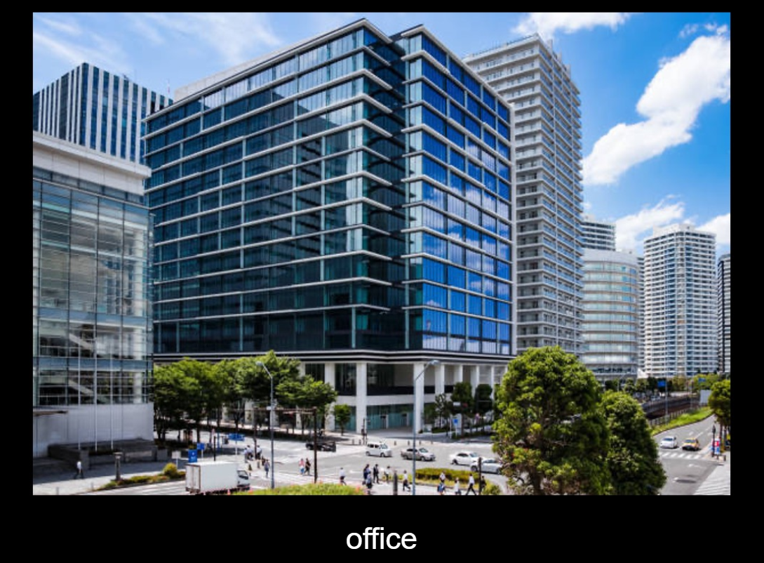
The buildings you will go into will look like this.
library
office
LEFT
RIGHT
PRESS THE RIGHT KEY TO CONTINUE

Slide 6
In each building, you will be able to move through a certain number of rooms. In each room you enter, you will ask the people in that room if they would like to come to the party.
You will be able to take a path through 3 rooms.
LEFT
RIGHT
PRESS THE RIGHT KEY TO CONTINUE

Slide 7

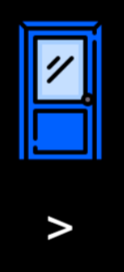
To move to a new room, you will choose between two doors like the ones below.
To choose the left door, you will press the < key. To choose the right door, you will press the > key.
LEFT
RIGHT
PRESS THE RIGHT KEY TO CONTINUE

Slide 8
Some rooms will have many friendly people where most will say yes.
Other rooms will have fewer friendly people. In these rooms, many people will say no.
While some people will say no, your goal is to get as many yes responses as possible so that your party will be a success.
We will keep track of how many people said yes and how many people said no as you move through the rooms.
LEFT
RIGHT
PRESS THE RIGHT KEY TO CONTINUE

Slide 9
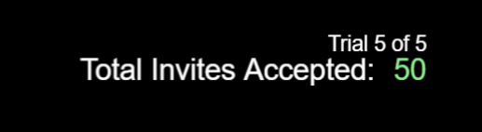
We will also keep track of how many yes responses you have gotten in total like this:
LEFT
RIGHT
PRESS THE RIGHT KEY TO CONTINUE

Slide 10
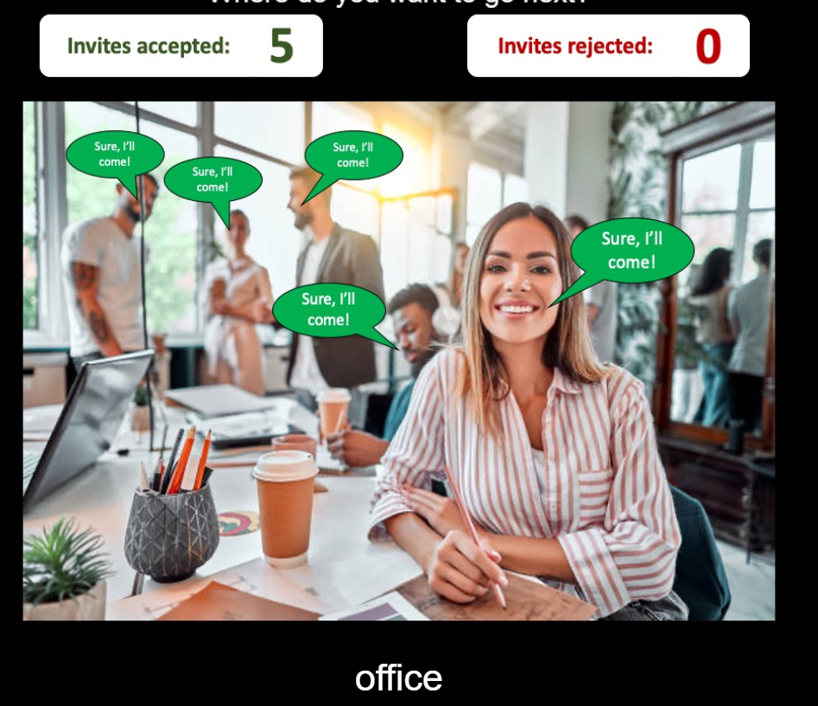
Here is an example room where 5 people said yes and 0 people said no.
LEFT
RIGHT
PRESS THE RIGHT KEY TO CONTINUE

Slide 11
Your main job in the game is to choose the sequence of doors that will lead to the most accepted invites.
In each room, choosing the left door will lead to a different room than choosing the right door. So, you will need to learn what doors lead to what rooms in each building.
Each room will always have the same people in it and tend to give you the same responses.
LEFT
RIGHT
PRESS THE RIGHT KEY TO CONTINUE

Slide 12
To visualize how the rooms in each building are connected, look at the diagram below. As you can see, the two doors in each room will lead to other rooms. The doors in each of those rooms will also lead to other rooms.
Version 1
Room 8
Room 9
Room 10
Room 11
Room 12
Room 13
Room 14
Room 15
Room 4
Room 5
Room 6
Room 7
Room 1
Room 2
Library/Office

Slide 13
There is only one path to each room in a building, and you cannot move backwards. In playing the game, you will have to learn this through trial and error.
Version 1
Room 8
Room 9
Room 10
Room 11
Room 12
Room 13
Room 14
Room 15
Room 4
Room 5
Room 6
Room 7
Room 1
Room 2
Library/Office

Slide 14
You will first play several games in the library.
You will then move to the office and play several games there.
For the first game in each building, you will only be allowed to choose one path. This means that only one door will be shown as an option. This will give you an example of what to expect.
For all other games, you will be able to choose for yourself which rooms to move through.
LEFT
RIGHT
PRESS THE RIGHT KEY TO CONTINUE

Slide 15
Now you are ready to complete Module 1.
Remember that your goal is to get as many yes responses as possible. People who say no do not count against your score.
Press the < key to choose the left door and press the > key to choose the right door.
Also remember that how much you get paid will depend on how well you perform on the task.
RIGHT
PRESS THE RIGHT KEY TO BEGIN

Slide 16
Press the RIGHT KEY to BEGIN!

Slide 17
Module 2
RIGHT
PRESS THE RIGHT BUTTON TO CONTINUE
Notes:
Outside the scanner

Slide 18
In this second module, we will show you how many people say yes in each room. We will start you in each room and you will be told to choose the left or right door in that room. Then you will see the outcome.
After you’ve seen each room, we will then test you on how well you remember. You will continue to be tested until you get each answer correct a few times.
LEFT
RIGHT
PRESS THE RIGHT BUTTON TO CONTINUE

Slide 19
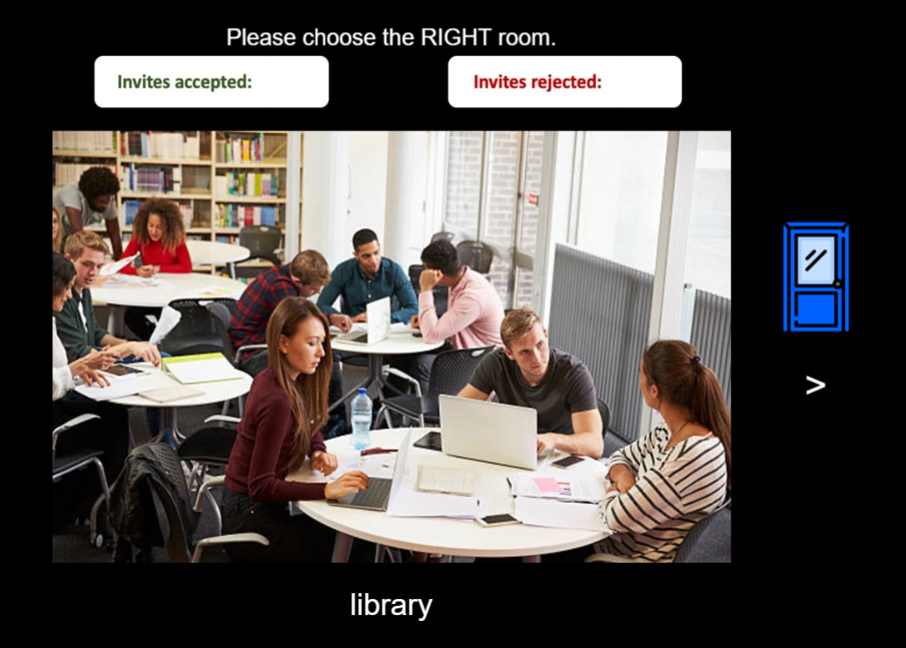
We will now show you each room. When you choose the instructed door, you will see the room you move to and how many yes responses you get.
LEFT
RIGHT
RIGHT
PRESS THE RIGHT BUTTON TO CONTINUE

Slide 20
Press the RIGHT KEY to BEGIN!

Slide 21
Now we will test you to see if you know how the rooms are connected.
In each room we start you in, we will ask you how many invitations will be ACCEPTED and REJECTED in the following rooms. This will be multiple choice, with 4 possible answers to choose from.
PRESS THE RIGHT BUTTON TO CONTINUE

Slide 22
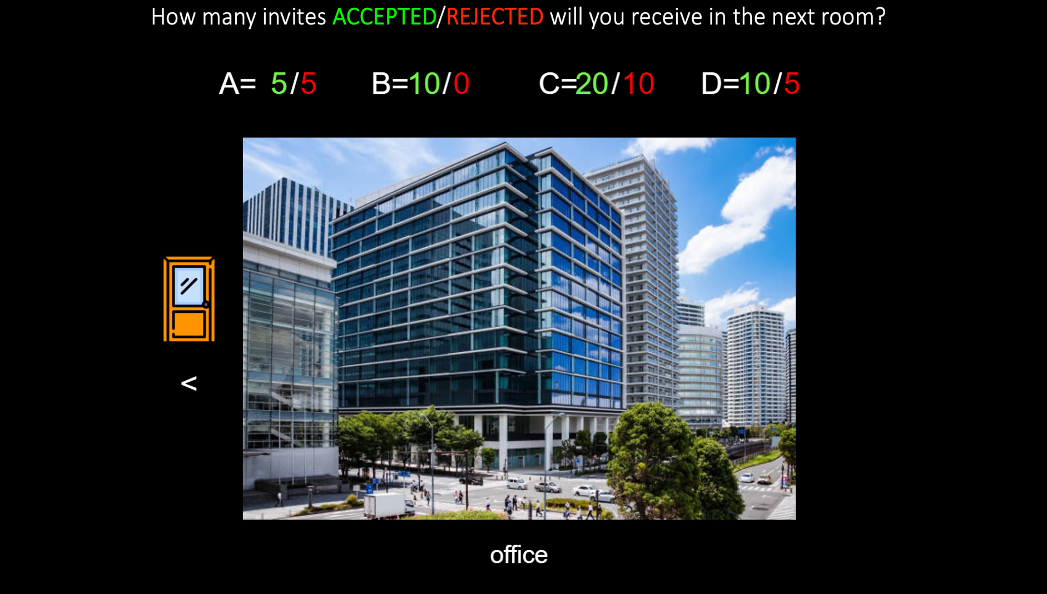
The rooms will look like this. You will need to give the correct answer in each room a few times before the module can finish.
A. 10/5 B. 5/5 C. 0/10 D. 20/0
PRESS THE RIGHT BUTTON TO CONTINUE

Slide 23
Press the RIGHT KEY to BEGIN!

Slide 24
Great job with Module 2!
Module 3
RIGHT
PRESS THE RIGHT BUTTON TO CONTINUE

Slide 25
In this final module, you will be asked to plan out a sequence of rooms you’d like to visit before you get to move through them.
You will only know which building you are going into and how many moves you will get at the start of each game. Sometimes, you will be able to enter 3 moves. In other games, you will only be able to enter 2 moves.
LEFT
RIGHT
PRESS THE RIGHT BUTTON TO CONTINUE

Slide 26
You will get 6 seconds to plan your path and 2 seconds to input your choices. During the response period, you will have to enter in your whole sequence.
For example, you could enter LEFT, LEFT, RIGHT if you wanted to take the left door in the first room, the left door in the second room, and the right door in the third room.
LEFT
RIGHT
PRESS THE RIGHT BUTTON TO CONTINUE

Slide 27
You will need to have this sequence of moves planned ahead of time during the 6-second planning period, since you only have a short time to respond. In other words, you will not have time to continue planning during the 2-second period when you can enter your moves.
As before, your goal is to get as many yes responses as you can. The number of no responses does not count against your score.
LEFT
RIGHT
PRESS THE RIGHT BUTTON TO CONTINUE

Slide 28
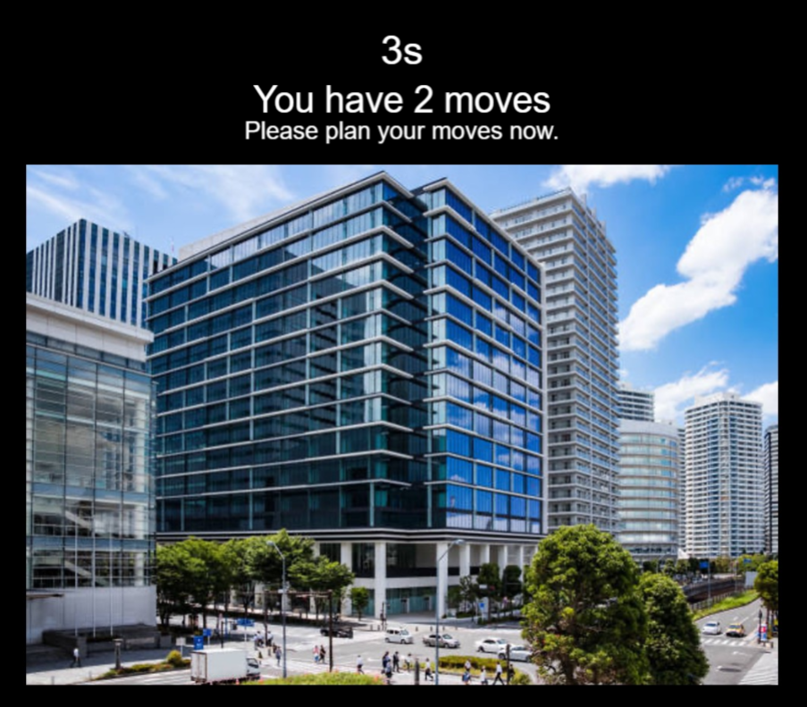
The screen for this module will look something like this:
6s
LEFT
RIGHT
PRESS THE RIGHT BUTTON TO CONTINUE

Slide 29
When the 6 seconds are up, it will look like this when you should quickly enter your moves:
6s
LEFT
RIGHT
PRESS THE RIGHT BUTTON TO CONTINUE

Slide 30
Now you will have you practice a couple practice trials before you play the real game.
Just like in previous modules, to choose the left door, press the < key. To choose the right door, press the > key.
LEFT
RIGHT
PRESS THE RIGHT BUTTON TO CONTINUE

Slide 31
Great Job!
We will now start the real game.
Good luck!
LEFT
RIGHT
PRESS THE RIGHT BUTTON TO CONTINUE

Slide 32
Great job!
Now you’re ready to play the real game.
Remember that your goal is get as many yes responses as possible. You will have 6 seconds to plan your moves and 2 seconds to make your choices.
Also remember that how much you get paid will depend on how well you perform on the task.
RIGHT
PRESS THE RIGHT BUTTON TO CONTINUE

Slide 33
Press the RIGHT KEY to BEGIN!

